Slide 1
Network Security
Group 5
Software
2018
SECURITY

Slide 2
Team Member and Division
/01

Slide 3
Team Member and Division
IP Security
DNS Security
刘龙权
刘益铭
龙思怡
凌赵奇
DoS & DDoS
PowerPoint
刘昱玮
刘玮琦
刘岳
卢垚松
Basic & Future
刘圃卓

Slide 4
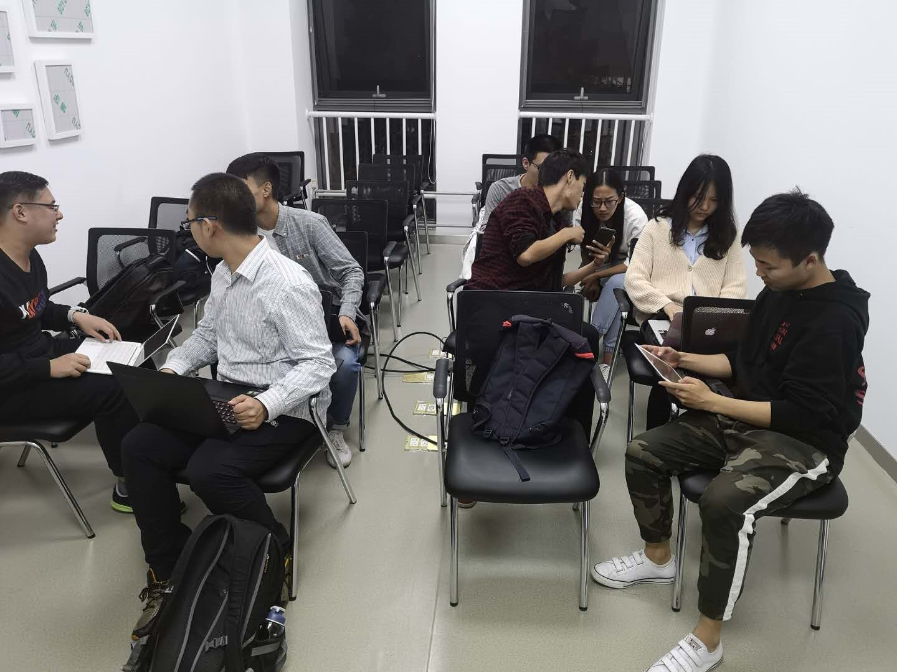
Team Member and Division

Slide 5
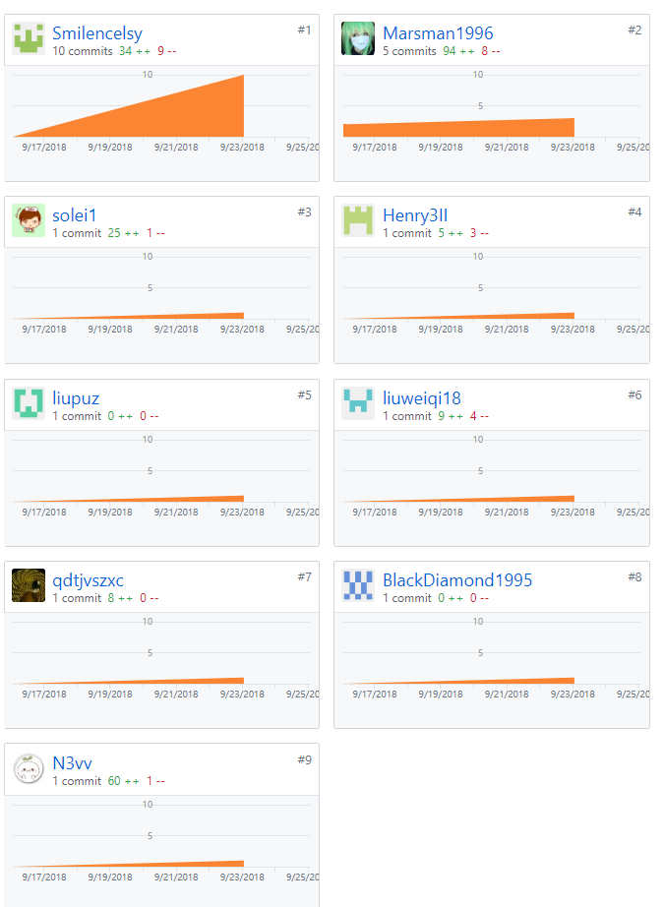
Team Member and Division

Slide 6
How the network works
/02

Slide 7
How the network works
Communication
Package
Through the parcel of layer protocol
Split and assembled at the destination
Basic
Computer Interconnection
Wired: dial-up connection, optical fiber
Wireless: wifi, data network
Notes:
网络如何工作：
计算机互相连接构成计算机网络，该链接可以是有线连接方式例如拨号连接、光纤，也可以通过无线连接，例如wifi、数据网络等。
主要通过 “包”的传递进行通信和交互，将数据等其它信息经过一层层协议的包裹进行发送，最终在目的地进行拆分组装。

Slide 8
IP Security
/03

Slide 9
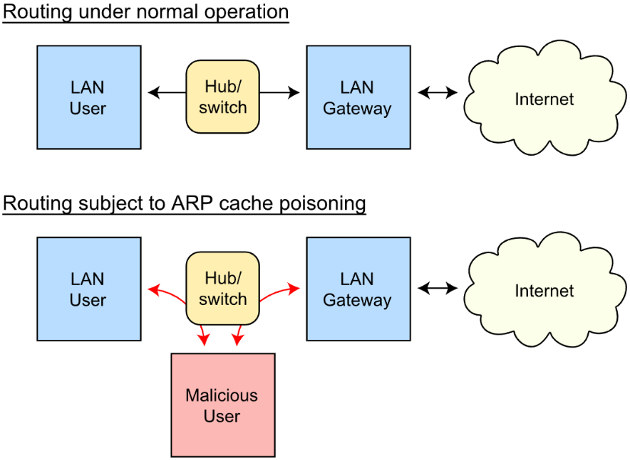
IP Security
Data Sniffer
Promiscuous
Mode
Set the network card to promiscuous mode to receive all packets.
Only in hub.
ARP Cache Poisoning
Arp cache is destroyed by the malicious host.
In switch.
Notes:
基于混杂模式的嗅探
网卡设置为混杂模式后，不会丢弃目的不是自己的数据包；仅在使用集线器情况下有效
基于arp欺骗的嗅探
破坏arp缓存，对交换机有效

Slide 10
IP Security
IP
Fraud
Attacker gains information or trust by fake IP or packages..
The way of IP fraud
Fake IP address; Source routing attack;
Trust in Unix
Tools
Nmap
HPing
Nemesis
Spoofer
Engage Packet Builder
IRPAS
IRPAS
The prevention of IP fraud
Random SYN; Packet filtering; Discard address-based trust
Encryption & verification protocol: IPSec; SSL
Relation work
FHSD: An Improved IP Spoof Detection Met-hod for Web DDoS Attacks
Systems and methods for ip source address spoof detection
Towards a SDN-Based Integrated Architect-ure for Mitigating IP Spoofing Attack
Notes:
TCP/IP网络中的每一个数据包都包含源主机和目的主机的IP地址，攻击者通过伪造数据包，获得未被授权访问的信息，或者使伪造的信息被目的主机信任并接收。
实现方法：简单的ip地址，源路由攻击，Unix中的信任关系 (补充)
防范方法 (补充)：抛弃基于地址的信任策略，进行包过滤，使用随机化的初始序列号，进行加密传输和验证：IPSec，SSL

Slide 11
DNS Security
/03

Slide 12
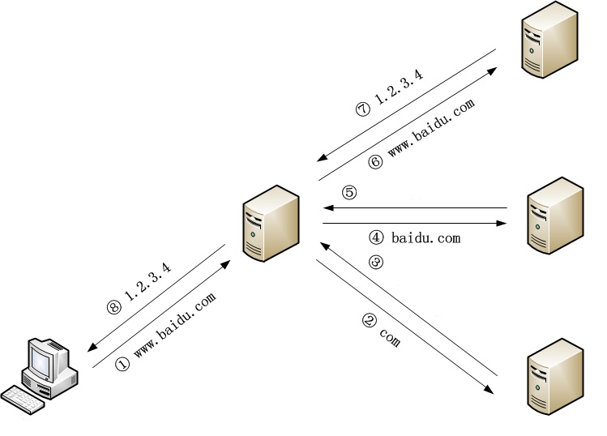
DNS Security
Vulnerability of DNS
Insecure UDP protocol
DNSSEC is not popularize
Malicious using of DNS
Use the server for DDoS attacks.
Use the server for botnet communication.
Redirect to a malicious website.
DNS redirection
Authoritative server
IP address of Authoritative server
Forged DNS server response
Recursive server
TLD Authoritative server
IP address of TLD server
Modify the recursive server cache
Client
DNS Root server
Notes:
DNS脆弱性：通过UDP协议通信，易被篡改，DNSSEC没有大范围普及
DNS攻击形式：DNS欺骗，DNS信息劫持，DNS重定向，DDos攻击
DNS恶意用途：DDOS攻击中的反射放大攻击，僵尸网络，钓鱼网站

Slide 13
(Distributed) Denial of Service
/04

Slide 14
(Distributed) Denial of Service
(D)DoS
Sends a lot of information to the target to crash the server.
Traditional DoS
SYN Flood; ACK Flood
UDP Flood; Challenge Collapsar
Reflective DDoS
Recent DoS
Attacker
Reflective DDoS
WebSocket DDoS
Fake IP
Prevention
Increase connection overhead
Invalid for DDoS
ISP filtering
Significantly reduced bandwidth
Refuse to forward fake packets
Need huge changes to protocol
Server1, 2, … , N
Huge data package
Victim
Notes:
传统DoS：SYN Flood攻击，ACK FLOOD攻击，Challenge Collapsar攻击，UDP FLOOD攻击
新型DoS：反射型DDoS，websocket DDoS
DoS防御：增加每次连接时的开销，但是对DDoS无效；ISP端过滤，使网络带宽明显下降；拒绝转发伪造的数据包：对现有协议做出较大改变

Slide 15
(Distributed) Denial of Service
Demonstration of SYN Flood
Use lots of fake IP for the first handshake in TCP.
Tools
Mininet; Netwox; Openbsd-inetd; Telnetd
Steps
Start mininet to create a network with one router s1 and three terminals h1, h2, h3.
Start telnet on h2.
Use telnet to verify that h2 can be linked by h3.
Use netwox to attack h2 through h1.
Notes:
使用伪造的IP地址或者只进行TCP协议中的第一次握手。
步骤：启动mininet创建带有1个路由器s1和3个终端h1, h2, h3的网络；为h2启动telnet；h3telnet链接h2验证正常状态下可以链接；h1使用netwox攻击h2

Slide 16
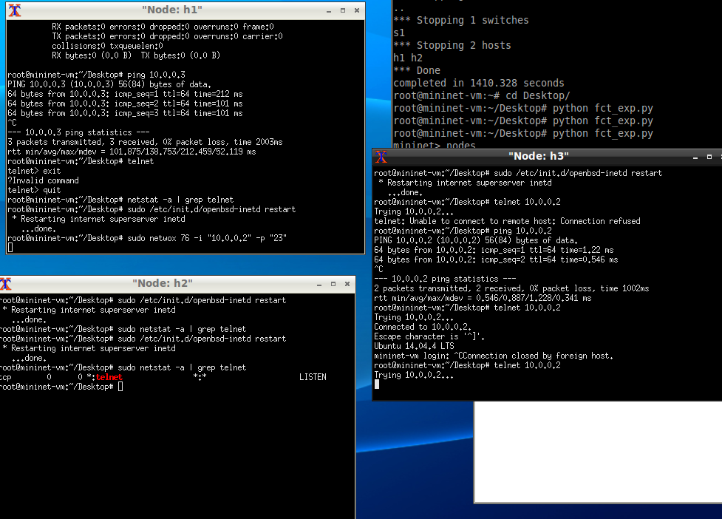
(Distributed) Denial of Service
Result of SYN Flood
After the attack, h3 could not link to h2.
Notes:
h1向h2发动攻击后，h3无法再链接h2

Slide 17
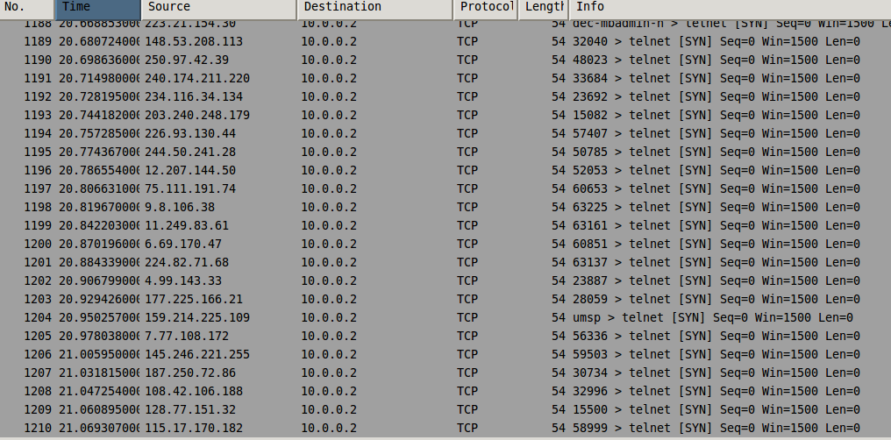
(Distributed) Denial of Service
Result of SYN Flood
Found a large number of SYN packages by wireshark.
Notes:
使用wireshark发现大量SYN包

Slide 18
Future of Network Seurity
/05

Slide 19
Future of Network Seurity
Trends of cyber threat
Network attacks combined with physical attacks
AI Malware
IoT Security
Social Engineering.
Responses
Cybersecurity law
Network security professionals
Identity Authentication
Secure Protocol
Cooperation with AI
Notes:
网络威胁发展趋势：网络攻击和物理攻击结合，人工智能恶意软件，物联网安全，社会工程
应对措施：网络安全法，培养专业人才，身份认证，安全协议，与AI领域合作

Slide 20
Network Security Group 5
THANKS
Software Security
2018

